Slide 1
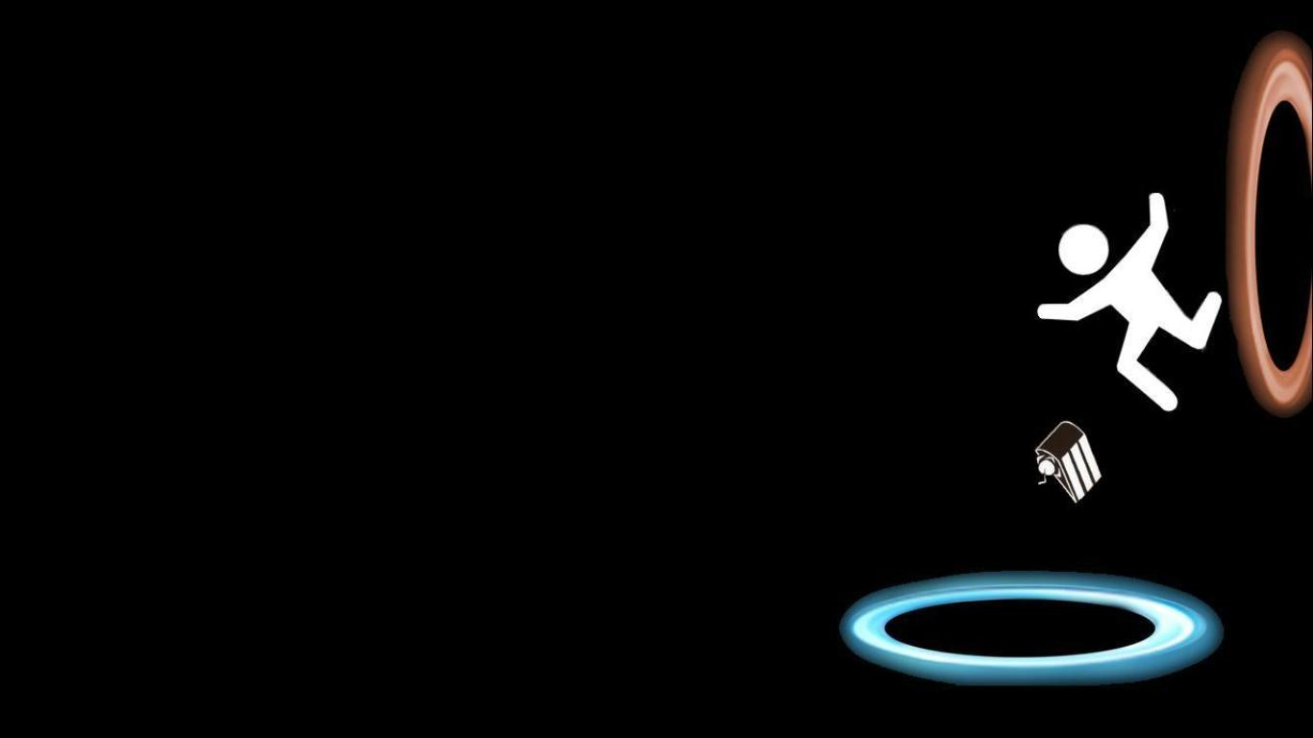
Portal 2D
Mahesh Velegonda

Slide 2
Game Mechanics
Shoot portals using the portal gun
Come up with ways to reach the exit of each level
The player can move around but each level is designed in such a way that the player has to use the portal gun.

Slide 3
Code Architecture
Extended Tom’s framework for the game’s needs
The following static managers are used to control the various aspects of the game
File Manager
Memory Manager
Level Manager
Input Manager
State Manger
Physics Manager
Animation Manager
Audio Manager
Rendering Manager

Slide 4
Code Flow
At the start of each level, the Level Manager reads the level data file and stores the level information in a data structure.
It also maintains the level state. At the end of the level it loads new level data.
The Level Manager passes on this information to the Physics Manager which initializes the physics engine. When a new level
The physics manager uses the Box2D physics engine which does cool stuff like ray casting, collision detection, applying force on the player etc.,

Slide 5
Audio Manager
Input Manager
Physics Manager
Rendering Manager
Animation Manager

Slide 6
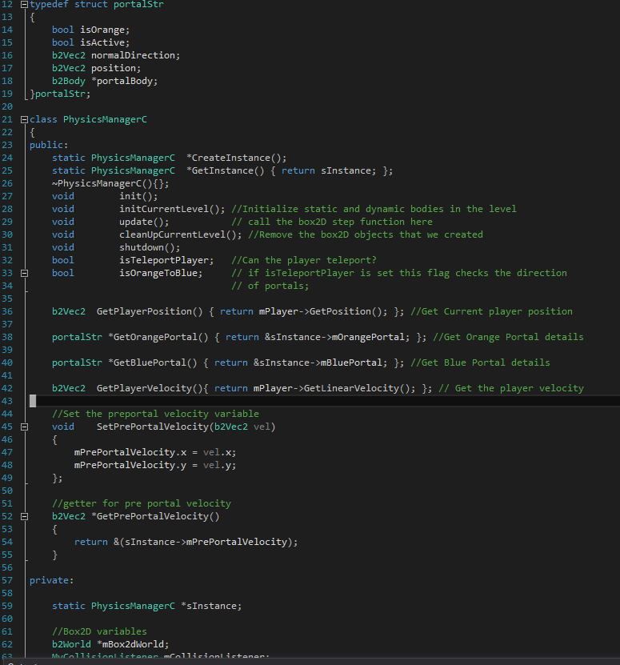
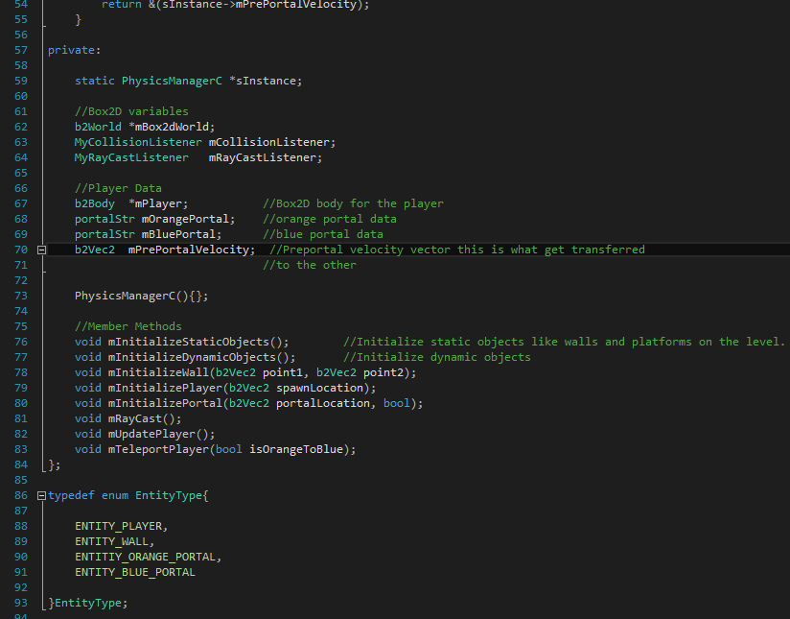
Physics Manager Class

Slide 7
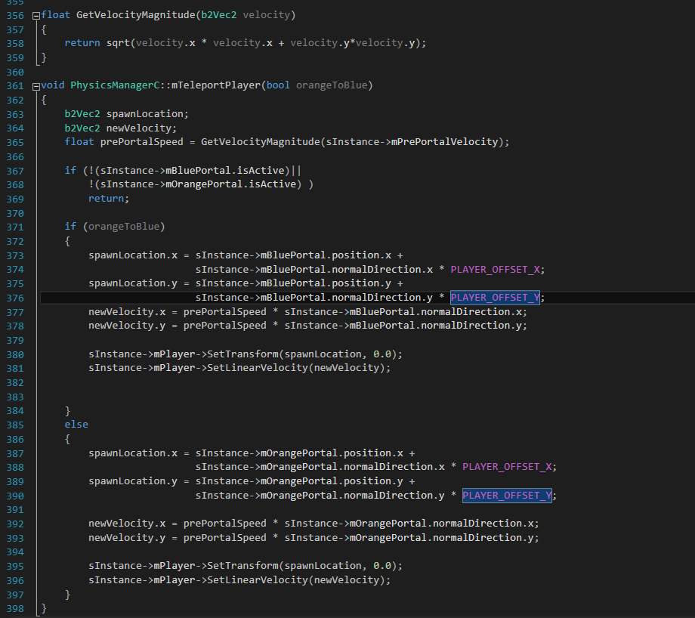
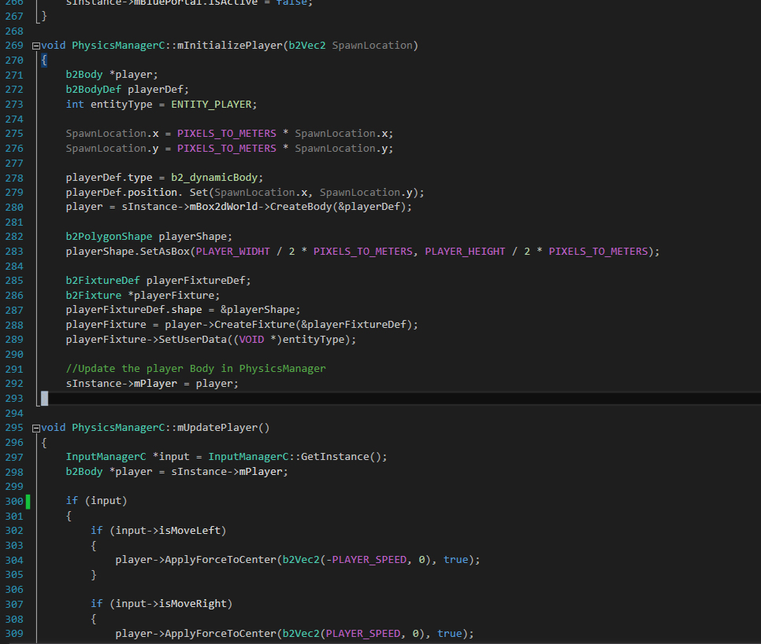

Slide 8
Challenges Faced
Understanding the box2D Coordinate system and the scale of objects
Problem was converting the simulations to OpenGL and display it on screen.
Way I fixed it was to change the OpenGL coordinate system to align with the box 2D coordinate system.
Other Challenges include the way RayCasting behaves in box2D.
I also had a hard time in drawing textures on screen – had to mess around with the order in which I draw the quad to get it to working.
Same thing with the ‘u’ ‘v’ texture mapping with the orthogonal coordinates I chose.

Slide 9
Things to work on
Level Manager
Memory Manager
Animation Manager
More Mechanics like Enemy AI and more dynamic objects in the scene.

Slide 10
Thank You.

